Slide 1
Virtual Private Network
Presented By: - Rituraj Gupta
1941012660
B.Tech CSE L
5th Sem

Slide 2
What is VPN
Virtual Private Network (VPN) is a technology that extends a private network over public network and enables to send and receive data across public network as if they being connected with a private network.
In simple manner it’s a technology that create a network that is public physically but virtually private.
It often secure data with encryption to prevent the breach of data to unauthorized parties.

Slide 3
Benefits of VPN
Safety and Security
Anonymity
Breaking Geo-Restrictions
Subsidized Shopping and Travelling
Using Public Wi-Fi
Adaptable to numerous devices
Easy to use

Slide 4
Requirements of VPN
Tunnelling
Encryption
Encapsulation
Authentication
Firewall

Slide 5
Tunneling
VPN is based on the idea of tunnelling.
It is a communication protocol that allows movement of data from one network to another through a process called encapsulation.
Tunneling protocol works by using the data portion of a packet to carry the packets that actually provided service.
In this an entire packet is placed within another packet before its transported over network.
Outer packet protects the content from public view and ensure movement through virtual tunnel.

Slide 6
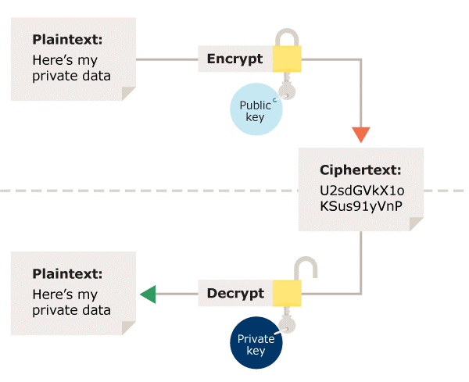
Encryption
It is a process where data is encoded so that only the device having decoder with the specified condition can decode the data to use it.
At each end of VPN virtual tunnel data is encrypted while entering the tunnel and decrypted while exiting the tunnel.

Slide 7
Encapsulation
For encapsulation VPN relies on technologies like GRE, IPSec, L2F, PPTP and L2TP

Slide 8
Authentication
Authentication is the process of determining whether someone or something is, in fact, who or what it says it is.
It determine the sender is authorized person and if data has been redirected or corrupted.
There are 2 level of Authentication
Computer-Level Authentication
User-Level Authentication

Slide 9
Firewall
A firewall is a network security device that monitors incoming and outgoing network traffic and decides whether to allow or block specific traffic based on a defined set of security rules.
It prevent attacks and secure data communication with multiple parallel VPN connection.

Slide 10
Types of VPN
Remote access VPN
Allows Individual user to establish secure connection with remote network
Intranet VPN
It corporate headquarters, offices over shared infrastructure over dedicated connection
Extranet VPN
In this user beyond the intranet corporate over intranet VPN

Slide 11
Advantages of VPN
Security
Reliability
Cost Saving
Scalability

Slide 12
Disadvantages of VPN
It require deep understanding of network security
VPN is not under an organization
Not compatible

